Slide 1
Presentation 3
Phase I: Machine Learning
Alireza Toghyiani - 10/02/2022

Slide 2
How calculate distance between rows of data?
There are many ways of calculating distance but the one used in TomekLink is Euclidean Distance
Numerical values may have different scales and this can impact the calculation so it would be better to normalize the data prior to calculating the distance measure.
The most commonly used distance measures:
Hamming Distance
Euclidean Distance
Manhattan Distance
Minkowski Distance

Slide 3
Calculate Distance
Hamming Distance
Calculates the distance between two binary vectors
HammingDistance = (sum for i to N abs(v1[i] – v2[i])) / N
Euclidean Distance
Calculates the distance between two real-valued vectors.
EuclideanDistance = sqrt(sum for i to N (v1[i] – v2[i])^2)
Manhattan Distance
The shortest path that a taxicab would take between city blocks
ManhattanDistance = sum for i to N sum |v1[i] – v2[i]|

Slide 4
Calculate Distance
Minkowski Distance
It is a generalization of the Euclidean and Manhattan distance measures and adds a parameter, called the “order”, that allows different distance measures to be calculated.
MinkowskiDistance = (sum for i to N (abs(v1[i] – v2[I]))^p)^(1/p)
Where p is the order:
p=1: Manhattan distance
p=2: Euclidean distance

Slide 5
F1-Micro VS F1-Macro
What is f1-score?
It is a measure of a model’s accuracy on a dataset. It is used to evaluate binary classification systems, which classify examples into ‘positive’ or ‘negative’.
The F-score is a way of combining the precision and recall of the model
Precision: the quality of a positive prediction made by the model. Precision refers to the number of true positives divided by the total number of positive predictions( true positives + false positives)
Recall: the measure of our model correctly identifying True Positives. Mathematically it means, the number of true positives divided by sum of true positives and false negatives

Slide 6
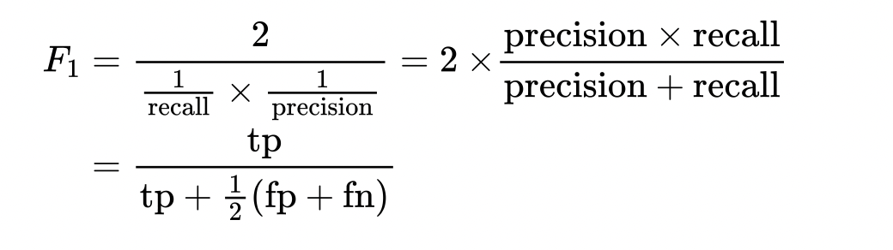
F1-Micro VS F1-Macro
The formula for the standard F1-score is the harmonic mean of the precision and recall
Macro-F1 = Arithmetic mean of the per-class F1-scores
Micro F1 = The harmonic mean of the precision and recall
Micro F1 is the F1-Score

Slide 7
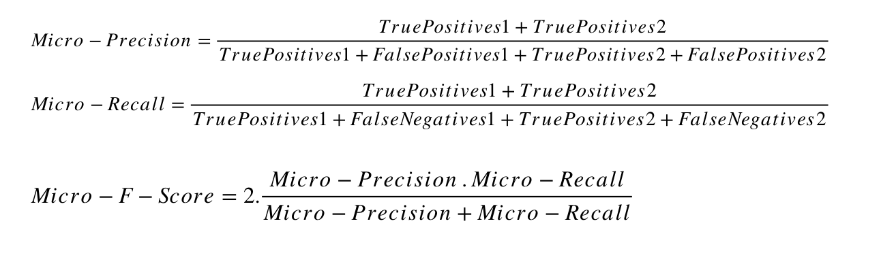
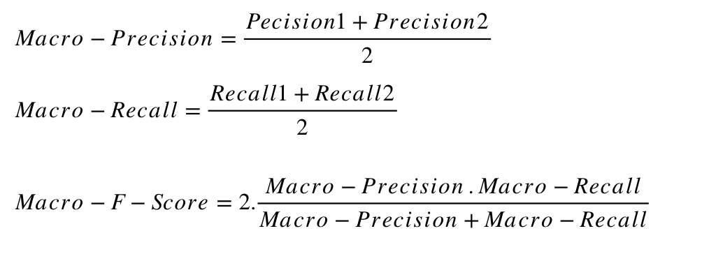
F1-Micro VS F1-Macro
Macro-averaged metrics are used when we want to evaluate systems performance across on different classes
Micro-averaged metrics should be used when the size of datasets are variable

Slide 8
Outliers
In statistics, an outlier is an observation point that is distant from other observations.
Outliers can either be a mistake or just variance, how would you decide if they are important or not.
How find outliers?
Scatterplot : could be used for multivariate outlier analysis
BoxPlot
Z-Score
The Z-score is the signed number of standard deviations by which the value of an observation or data point is above the mean value of what is being observed or measured
Find those data which are further than our threshold from zero
IQR score
The IQR is the first quartile subtracted from the third quartile; these quartiles can be clearly seen on a box plot on the data.

Slide 9
Feature Selection
A feature is relevant if it has some relation to our label
Reducing the features helps speed up and improve algorithms
How find these features:
Correlation: linear
Mutual information: non-linear
Tree-based methods
Trial and error with combination of features

Slide 10
Find Papaers
EDA: Easy Data Augmentation Techniques for Boosting Performance on Text Classification Tasks
Data augmentation for improving deep learning in image classification problem
The Effectiveness of Data Augmentation in Image Classification using Deep Learning
Data augmentation for ML-driven data preparation and integration
On the combination of data augmentation method and gated convolution model for building effective and robust intrusion detection
Data Augmentation based Malware Detection Using Convolutional Neural Networks
A Comparison on Data Augmentation Methods Based on Deep Learning for Audio Classification
Comparison of Different Image Data Augmentation Approaches
Adaptive data augmentation for supervised learning over missing data
Dataset Generation for Development of Multi-Node Cyber Threat Detection Systems
Data Augmentation for Deep Neural Networks Model in EEG Classification Task: A Review
Conservative Data Sharing for Multi-Task Offline Reinforcement Learning
Machine Learning and EU Data-Sharing Practices: Legal Aspects of Machine Learning Training Datasets for AI Systems
Identifying Data Sharing in Biomedical Literature

Slide 11

Next Week
Correlations:
Feature Selection
Mutual information
Decision Tree & Random Forest
Supervised/ Semi-Supervised/Unsupervised
Cross-Validation
Accuracy Metrics for models

Slide 12
Colab Link

Slide 13
Q & A

Slide 14
Thanks for your attention!

